Slide 1
medics Patient App

Slide 2
Patient App Architecture
Layer 3
Layer 1
Layer 2
medics 5.0 App
medics 5.0
API
Handlers
medics 4.0 App
medics 4.0
Node.js Server for Patient App
API
Handlers
Patient Mobile App
medicseasy App
mediceasy
API
Handlers
Local Store
SqlLite
Mongo db
medics 4.3 App
medics 4.3
API
Handlers

Slide 3
User Profile & Family Member APIs
User Registration
  Sign-Up
    Create Profile
    Resend OTP
    OTP Verification
    Update Profile
  Sign-In
    Get OTP
    OTP Verification
Family member
  Adding Family Member
  Deleting Family Member

Slide 4
Appointment APIs
Appointment
  Get Hospitals
  Get Specialty
  Get Doctor
  Get Free Slots
  Book Appointment
  Appointment Re-Schedule
  Appointment Cancellation
  Get Up-coming Appointments
Get Notifications & Reminders

Slide 5
Visit Record APIs
Get Patient Visits
Get Active Prescriptions
Get Visit Record
  Demographics
  Chronic Illnesses
  Allergies
  Medical History
  Previous / Current Prescription
  Diagnosis
  Investigations Results
  Bills

Slide 6
Conceptual Diagram
User Profile
Family Member
1
1..n
1
1
0..n
Attachments
0..n
Patient & Hospital Map
Hospital
1..n
1
1
0..n
1
1
1..n
1..n
Appointment
Visit Record
Reminder
1..n
1

Slide 7
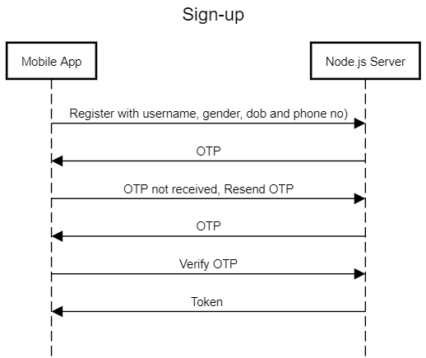
Sequence Diagram: Sign-up

Slide 8
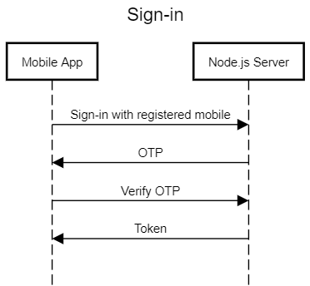
Sequence Diagram: Sign-in

Slide 9
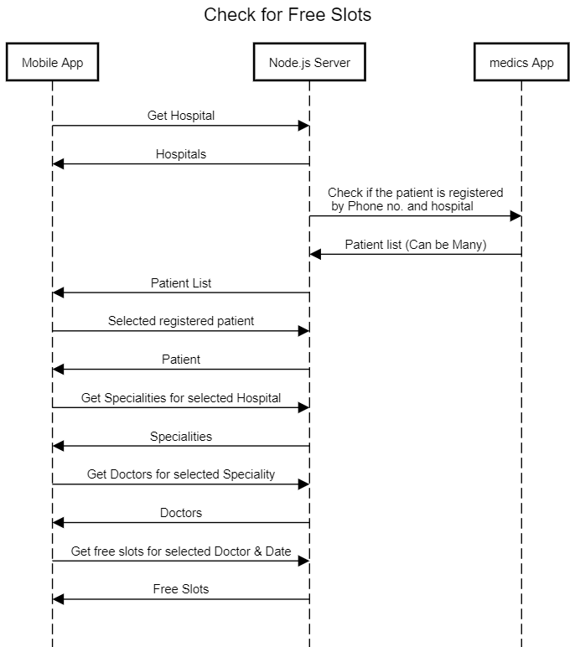
Sequence Diagram: Check for free slots

Slide 10
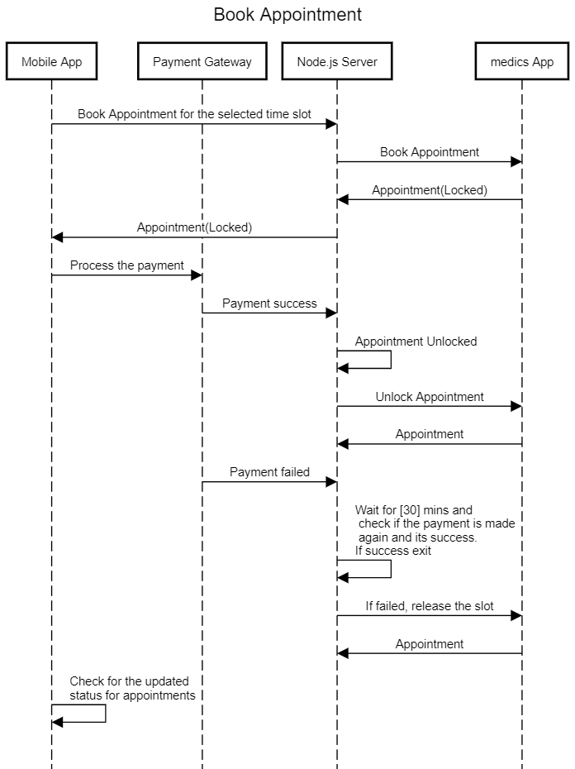
Sequence Diagram: Book Appointment

